Slide 1

Hospital Database Management System

Slide 2
Introduction
Hospital Database Management System (DBMS) plays a pivotal role in modern healthcare infrastructure by efficiently managing and organizing patient data, appointments, medical records, prescriptions, billing, and more.
It streamlines administrative tasks, improves workflow efficiency, and enhances overall patient experience.
With the increasing volume and complexity of healthcare data, a robust DBMS becomes indispensable for healthcare facilities to maintain data integrity and comply with regulatory requirements.

Slide 3
Entities, Attributes, Relationships
Entities: Patient, Doctor, Appointment, Lab Test, Prescription, Medical Record, Bill, and Claim.
Attributes: Each entity have at least 4 attributes. For Ex: Patient Entity has attributes Patient ID, Name, DOB, Gender, Blood Type, Address, and Insurance Policy No.
Relationships between each entity is either 1:1 (Bill to Claim) or 1:M (Patient to Appointment, Doctor to Appointment, Appointment to Lab Test and so on).
Doctor
Appointment
Lab Test
Medical Record
Bill
Prescription
Claim
Patient

Slide 4
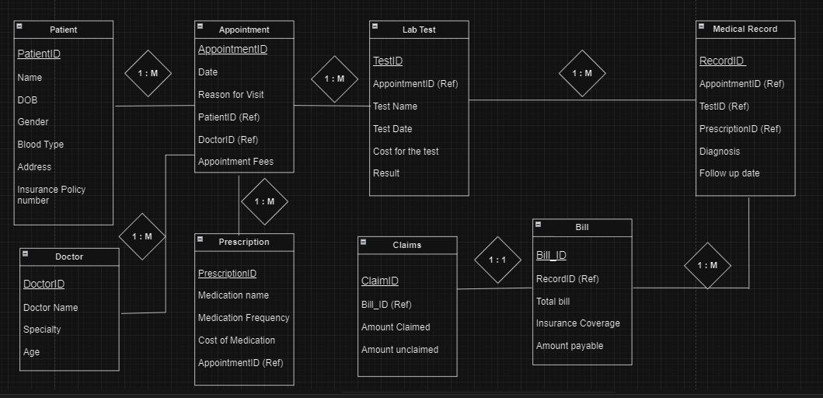
Entity-Relationship Diagram

Slide 5
Key Functions
Patient Management: Capturing and managing patient demographics, medical history, and insurance information.
Appointment Scheduling: Facilitating the scheduling and tracking of patient appointments with healthcare providers.
Lab and Prescription Management: Storing and organizing information about patient lab tests and medication history and also aiding billing and claims processing.
Medical Records Management: Storing and organizing comprehensive medical records, including diagnoses, treatments, and lab results.
Billing and Claims Processing: Generating accurate bills, managing insurance claims, and tracking payment transactions.
Reporting and Analytics: Generating reports and insights to support decision-making, resource allocation, and performance evaluation.

Slide 6
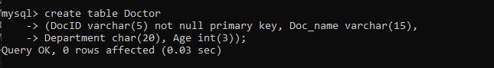
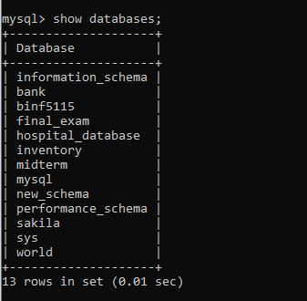
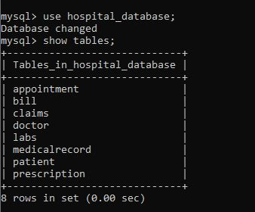
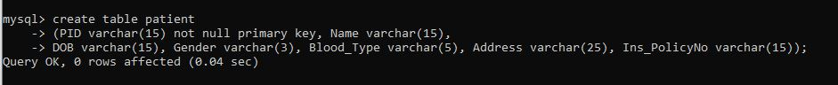
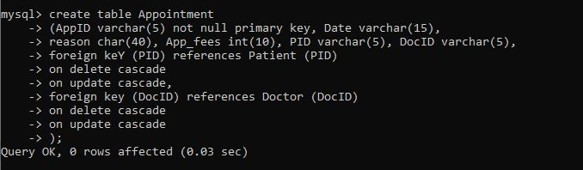
Process & Method

Slide 7
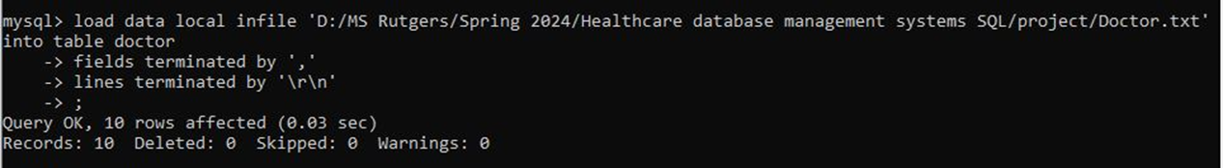
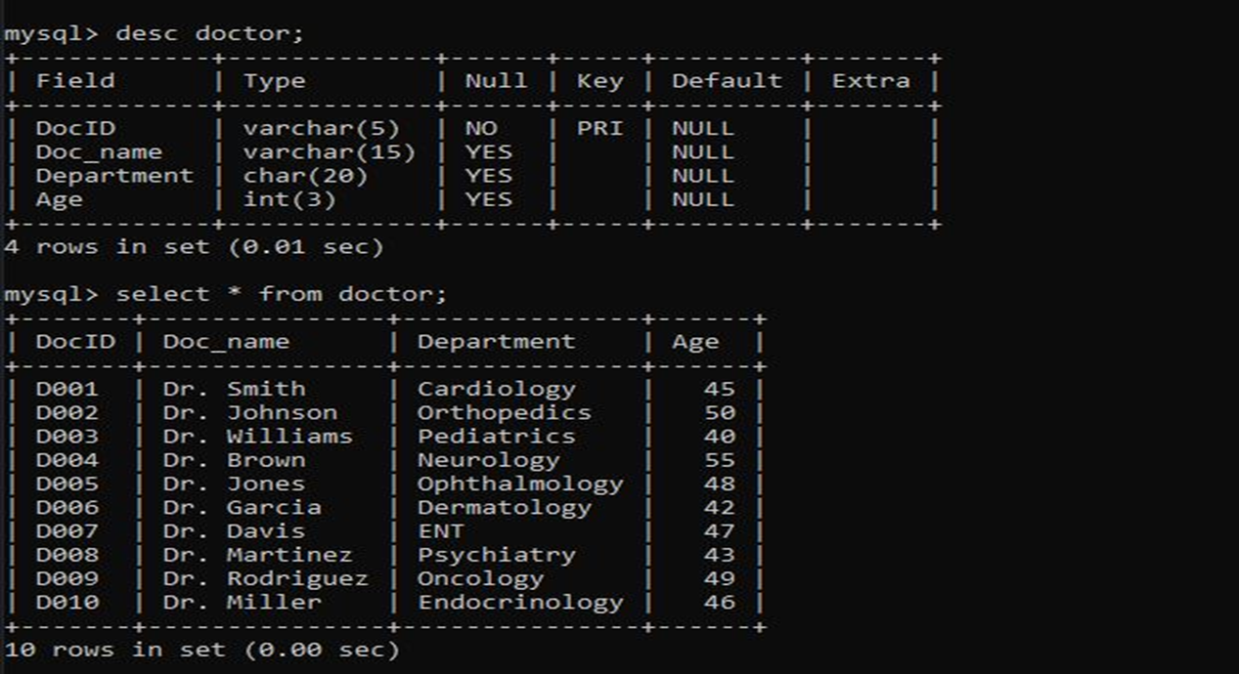
Loading txt files into the respective tables

Slide 8
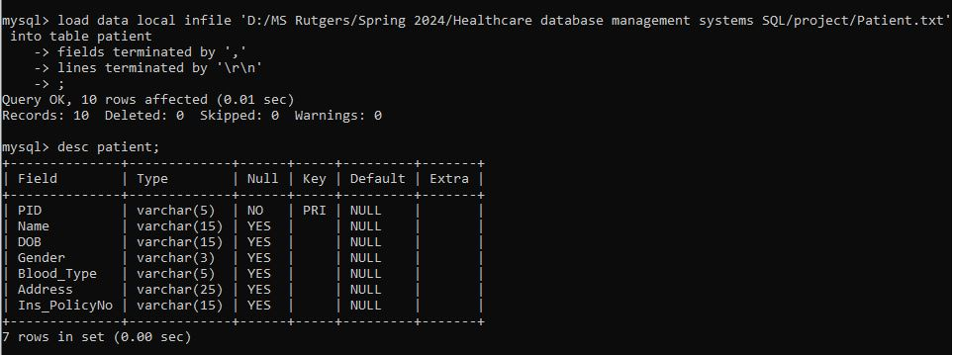
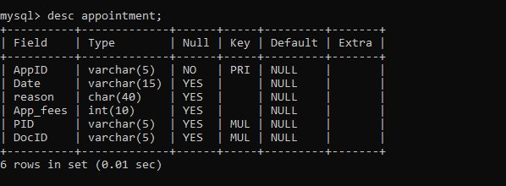
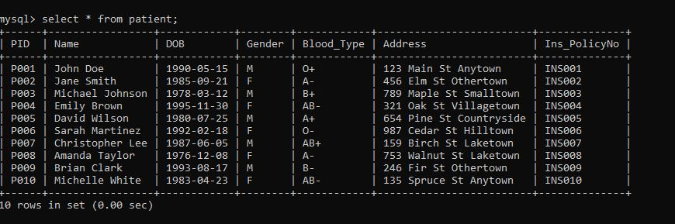
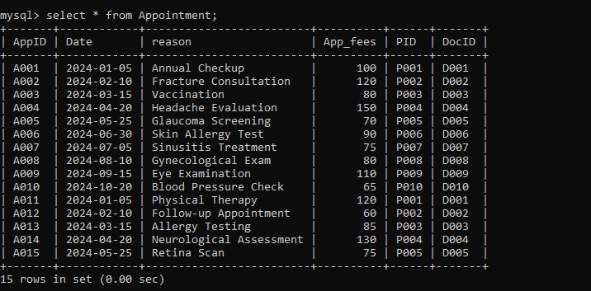

Slide 9
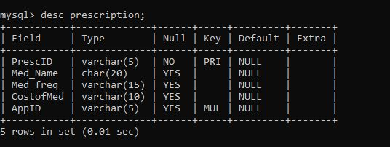
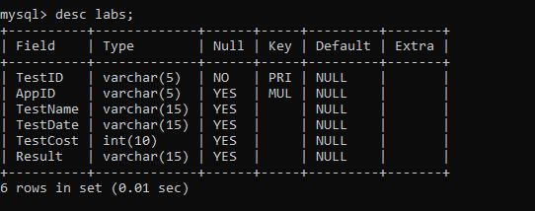
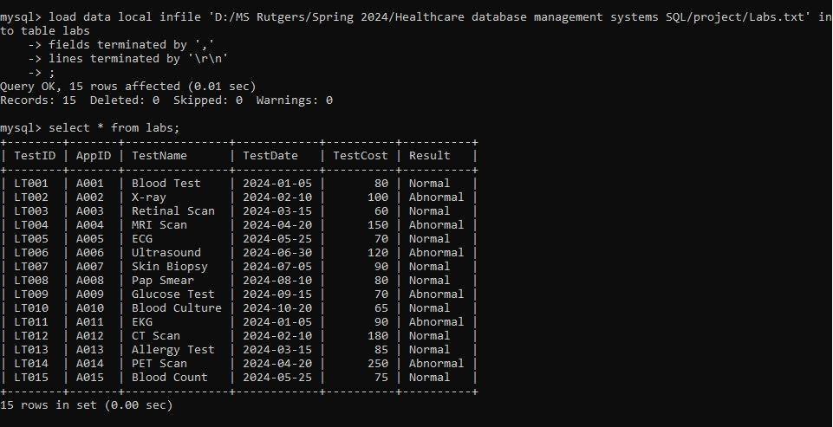
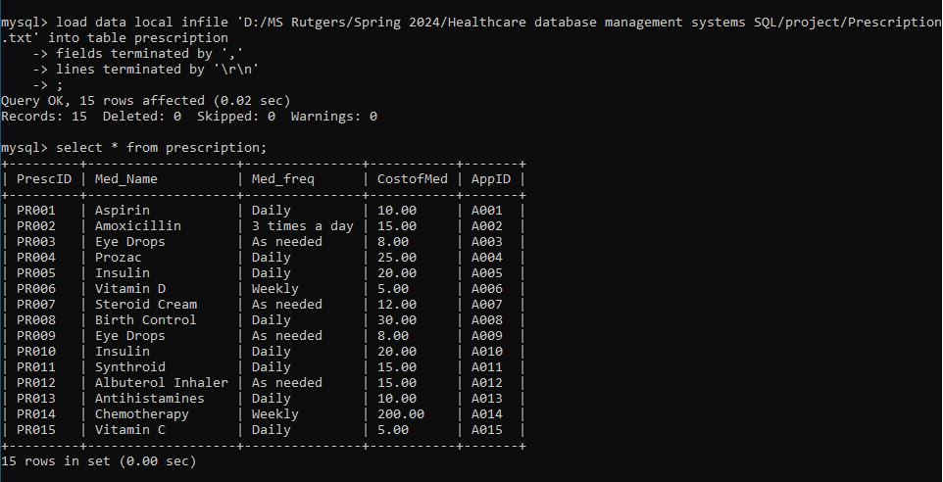

Slide 10
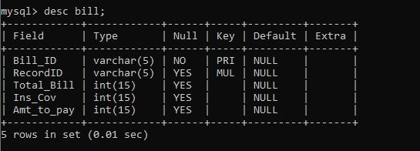
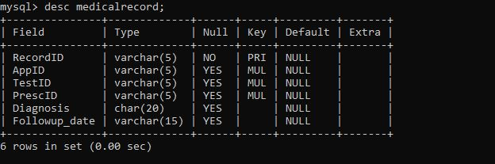
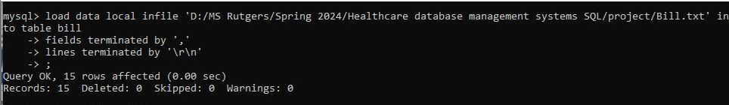
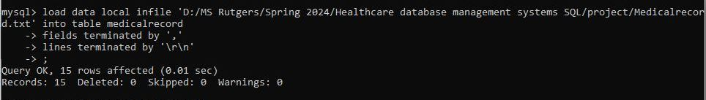
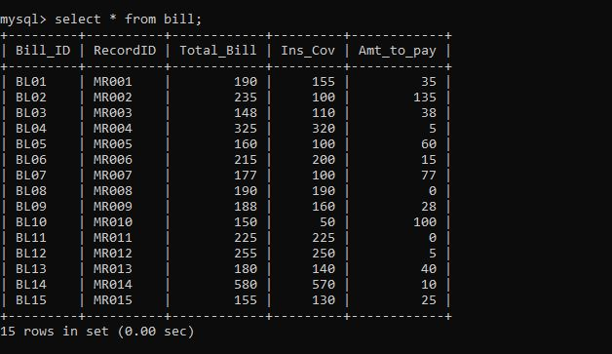
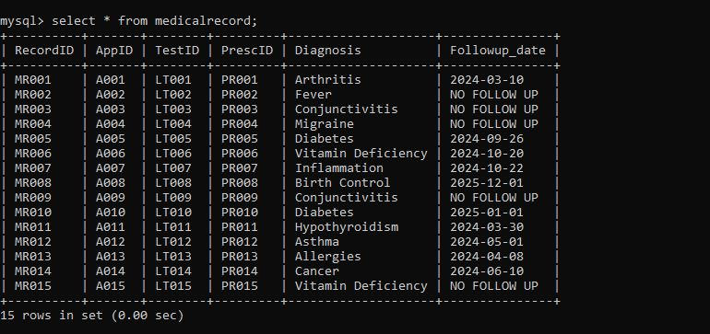

Slide 11
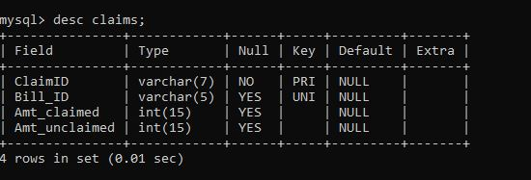
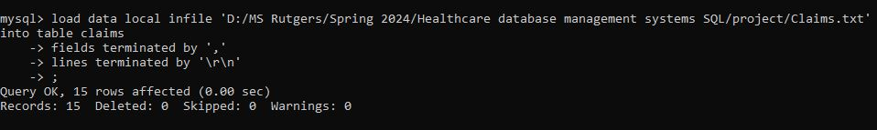
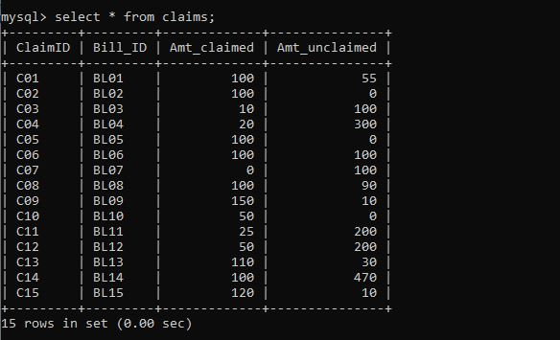

Slide 12
Objectives
Total patients by gender
Patient blood groups
Appointments scheduled for each doctor
Patients with follow up appointments
Number of lab tests ordered by each doctor
Total revenue
Revenue by department
Revenue claimed, unclaimed from insurance and Amount that patients paid
Percentage of total revenue covered by Insurance
Overall Patient report
Deleting few appointments to test delete update cascade function

Slide 13
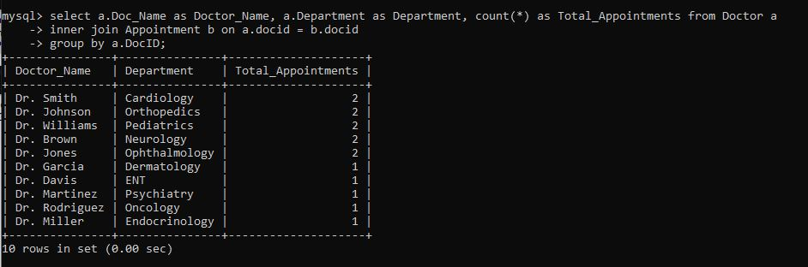
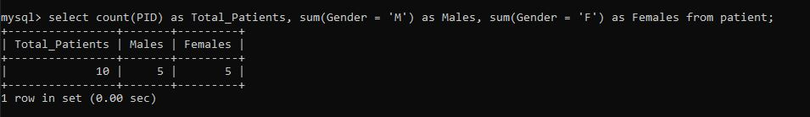
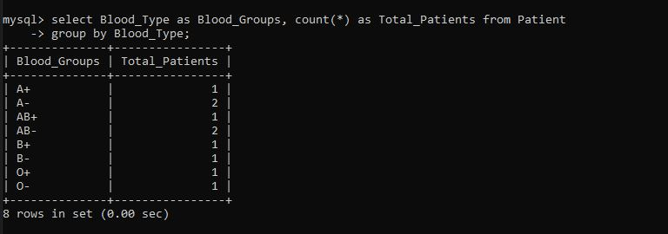
3. Appointments scheduled for each doctor
1. Total male and female patients
2. Patient Blood groups

Slide 14
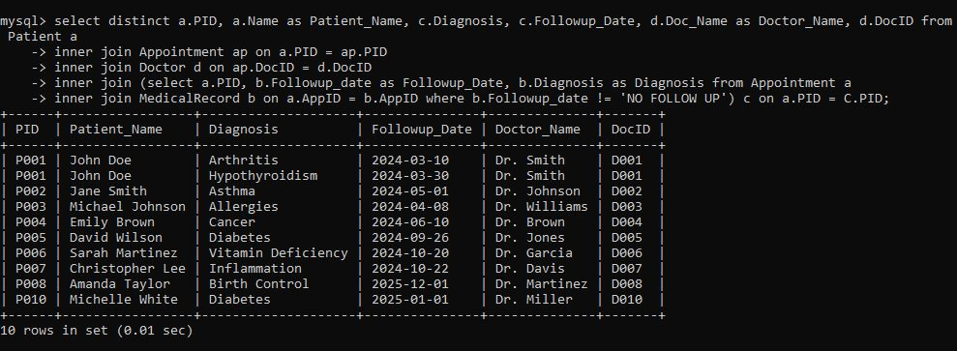
4. Patients with follow up appointments

Slide 15
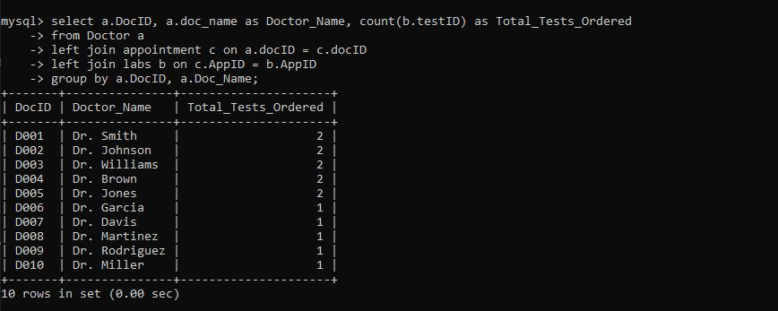
5. No. of lab tests ordered by each doctor

Slide 16
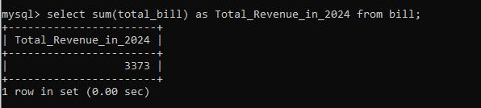
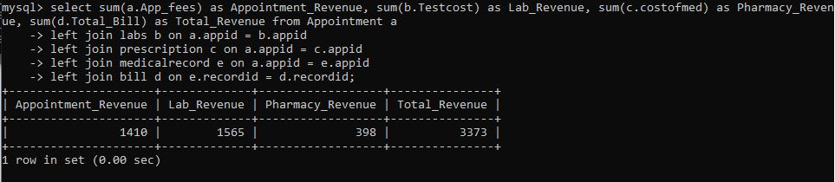
6. Total Revenue generated
7. Revenue generated by each department

Slide 17
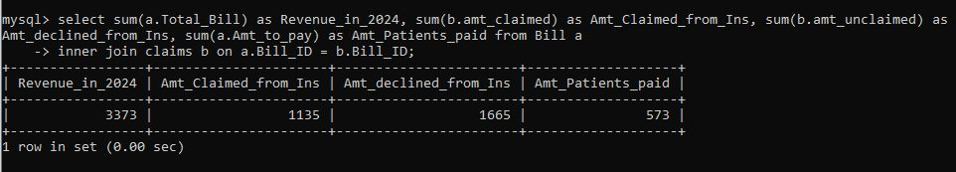
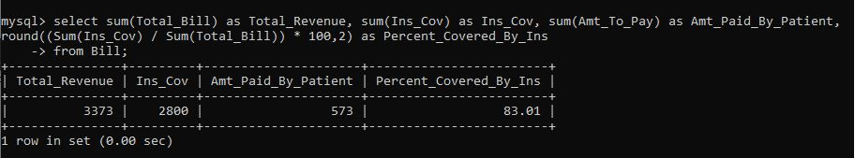
8. Revenue breakdown (Claimed, Unclaimed)
9. Percentage of Revenue covered by Insurance

Slide 18
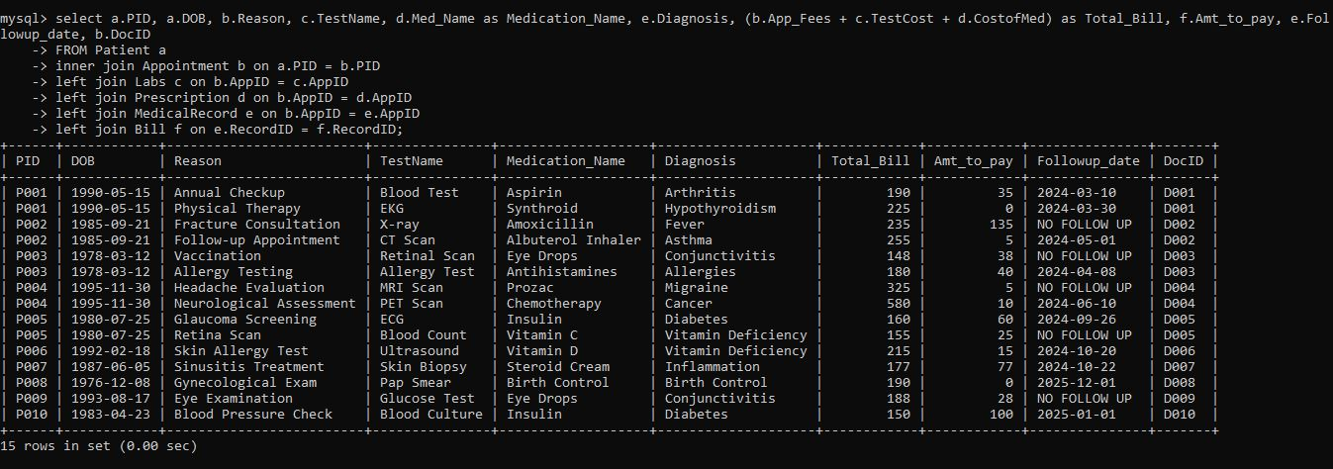
10. Overall patient report

Slide 19
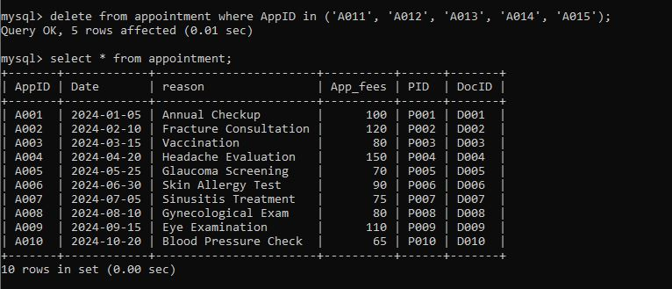
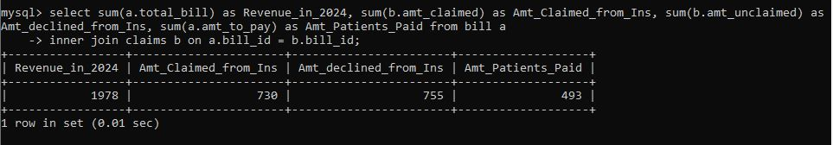
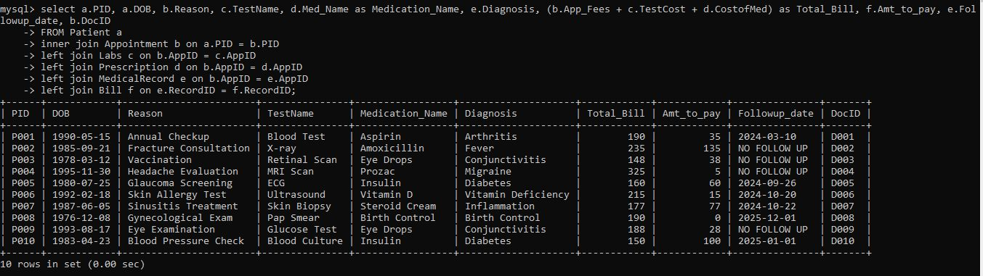
11. Deleting rows

Slide 20
Conclusion
The hospital database management system presented in this project is entirely fictional, and all the data included are fabricated for the purpose of demonstration.
In an increasingly digitized world, hospital DBMS will become even more vital in managing the complexities of healthcare data, ensuring data security, and facilitating seamless communication among healthcare providers.
The adoption of advanced hospital DBMS will be instrumental in enhancing patient outcomes, reducing medical errors, and optimizing resource allocation.

Slide 21

Created & Presented by
Ajith Kumar Kannan

